Slide 1

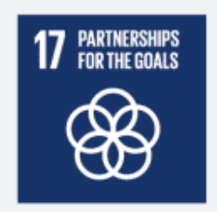
Voice/Textual Bot Mobile App
Presidency University
PIP2001 Capstone Project
Review-1
Batch Number: 118
Under the Supervision of,
Dr. Abdul Khadar A
Associate Professor
School of Computer Science and Engineering
Presidency University
Roll Number 20221LCS0036 20221LCS0033 20211CSE0658 20211CSE0636 20211CSE0699 | Student Name Ameena Sardar Lakshmi M Nirmala r Soujanya Badawadagi Bugga Ishwarya
Name of the Program: CSE
Name of the HoD: Dr. Blessed Prince P/Dr. Robin Rohit/Dr.Asif Mohammed H.B
Name of the Program Project Coordinator: Mr. Amarnath J.L & Dr. Jayanthi. K.
Name of the School Project Coordinators: Dr. Sampath A K / Dr. Abdul Khadar A / Mr. Md Ziaur Rahman

Slide 2
Introduction
Title :
Cross-Platform Voice/Textual BOT for Structured and Unstructured Interactions
Abstract:
This project aims to develop a cross-platform mobile BOT application for Android and iOS that allows users to interact using voice and text.
The BOT can handle structured queries (e.g., "What is my order status?") and unstructured queries (e.g., "status"), responding by fetching relevant data from a backend database.
It utilizes Natural Language Processing (NLP) for understanding unstructured queries and Google Cloud Speech API for voice processing.
The app will feature an open architecture, enabling it to integrate with multiple databases and systems for various applications.

Slide 3
Literature Review
BOTs and AI: Research on voice and textual chatbots.
Cross-platform development: Studies comparing frameworks like Flutter and React Native.
NLP: Papers that discuss Natural Language Processing, especially in handling unstructured queries.
Voice interaction: Technologies like Google Cloud Speech API or Amazon Polly.
Backend integration: How modern apps integrate with backend systems and databases.

Slide 4
Literature Review
Research Papers:
https://www.ripublication.com/ijaer18/ijaerv13n17_20.pdf
https://www.irjmets.com/uploadedfiles/paper//issue_10_october_2023/45644/final/fin_irjmets1698841142.pdf
https://www.researchgate.net/publication/357839467_A_Literature_Survey_of_Recent_Advances_in_Chatbots
https://www.researchgate.net/publication/367369151_Chatbots_Development_Using_Natural_Language_Processing_A_Review
https://library.imaging.org/admin/apis/public/api/ist/website/downloadArticle/ei/33/3/art00004
https://www.researchgate.net/publication/380860112_Natural_Language_Processing_in_Chatbots_A_Review
https://www.mdpi.com/2078-2489/13/1/41
https://www.researchgate.net/publication/352384737_A_Literature_Review_on_chatbots_in_education_An_intelligent_chat_agent

Slide 5
Literature Review
https://www.researchgate.net/publication/380860112_Natural_Language_Processing_in_Chatbots_A_Review
https://www.ripublication.com/ijaer18/ijaerv13n17_20.pdf
https://www.mdpi.com/2078-2489/13/1/41
https://www.irjmets.com/uploadedfiles/paper//issue_10_october_2023/45644/final/fin_irjmets1698841142.pdf
https://www.google.com/url?sa=t&source=web&rct=j&opi=89978449&url=https://ijarst.in/public/uploads/paper/599981706780184.pdf&ved=2ahUKEwiuhtrPlZOJAxW22DgGHXoGORgQFnoECB8QAQ&usg=AOvVaw3hPKPYTgKc-z2JaRJR8QCA
https://www.researchgate.net/publication/341730184_An_Overview_of_Chatbot_Technology
https://www.google.com/url?sa=t&source=web&rct=j&opi=89978449&url=https://www.ripublication.com/ijaer18/ijaerv13n17_20.pdf&ved=2ahUKEwiZ-YuWlJOJAxUM4zgGHTmdLYIQFnoECBMQAQ&usg=AOvVaw2h6YmmFIYkwSEykO_2xk1x
https://www.researchgate.net/publication/367369151_Chatbots_Development_Using_Natural_Language_Processing_A_Review

Slide 6
Existing method Drawback
Research existing BOT solutions (like Siri, Alexa, etc.), or BOT platforms such as Dialogflow and Rasa. Focus on identifying their shortcomings:
They might not handle unstructured queries well.
Limited integration with various backend systems.
Many BOTs are locked into specific ecosystems (e.g., only for Android/iOS).
Handling Unstructured Queries: Existing solutions may struggle with vague, unstructured inputs. Your project should use well-trained NLP models and handle fallback gracefully.
Backend Integration: Existing BOTs (especially Siri, Alexa) have limited backend integration capabilities due to being locked into their ecosystems. Your project’s open architecture will allow for greater flexibility in connecting to multiple backends.
Ecosystem Lock-in: Many current BOTs are tied to specific platforms, limiting their reach. Your cross-platform approach (using Flutter/React Native) ensures that the BOT can be deployed across different devices and platforms without ecosystem restrictions.

Slide 7
Proposed Method
User Interaction Flow:
User Input: The user interacts with the BOT through voice (via Google Cloud Speech API) or text.
NLP Processing: The input (whether structured or unstructured) is sent to Dialogflow/Rasa, which interprets the user’s intent and extracts key information.
Backend Query: Based on the user’s request, the BOT communicates with the backend database (e.g., Firebase, MySQL) via APIs to fetch the required information (e.g., order status).
Response: The BOT sends back a response, which can either be in text form (for textual inputs) or converted to speech (using Google Cloud Text-to-Speech) for voice interactions.
This setup ensures that the BOT can handle structured and unstructured queries efficiently, operate on multiple platforms, and integrate smoothly with various backend systems, all while offering real-time, dynamic voice and text interactions.

Slide 8
Objectives
Develop a cross-platform mobile app for voice and text interaction.
Implement structured query handling to provide precise responses.
Integrate Natural Language Processing for unstructured query handling.
Create an open architecture that can connect to various backend systems.
How to Achieve Open Architecture:
API-Driven Design: Your BOT will use RESTful APIs to communicate with different backend systems.
Middleware Layer: Acts as the intermediary between the BOT and backend, handling requests, processing data, and ensuring security.
Backend Flexibility: Your BOT can integrate with various databases (Firebase, MySQL, etc.) and services (shipping, payments, etc.) to fetch data dynamically.
NLP Integration: NLP (Dialogflow or Rasa) helps handle unstructured queries, converting them into actionable requests to the backend.
Scalability: The architecture can be extended to support additional services, databases, or third-party systems.
This setup ensures that the BOT is modular, adaptable, and capable of integrating with various backend systems, making it flexible and scalable for future needs.

Slide 9
Methodology/Modules
User Interface: Allows users to input queries and receive responses via text or voice.
Voice Processing: Converts spoken queries to text and text responses to speech.
NLP Engine: Understands user queries (both structured and unstructured) and decides what action to take.
Backend Communication: Fetches data from the database (e.g., order status) and processes it to provide real-time responses.
Example Scenario:
User Input via UI: The user types, "What’s my order status?" or speaks the command.
Voice Processing (if voice): The Speech-to-Text system converts the spoken query into text.
NLP Engine: The query goes to the NLP engine (e.g., Dialogflow), which detects the intent (checking order status) and extracts the order number or user ID.
Backend Communication: The BOT sends an API request to the backend database to fetch the user’s order status from the server (Firebase or MySQL).
Response to User: The BOT receives the order status from the database and responds to the user through the UI. If the interaction is voice-based, the response is converted into speech using Text-to-Speech.

Slide 10
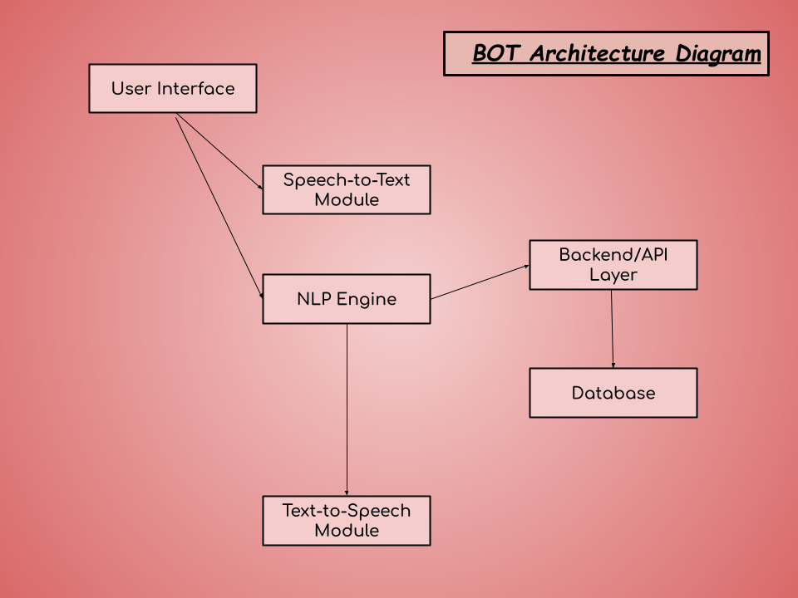
Architecture

Slide 11
Architecture
Architecture Diagram:
Frontend (Mobile App): This is the user interface, where users interact with the BOT. They can input queries using text or voice.
Speech-to-Text Module: If the user speaks a query, this module converts their voice into text so the BOT can process it.
NLP Engine (Dialog flow/Rasa): The Natural Language Processing engine processes the user’s input (whether it’s structured or unstructured). It determines the intent and extracts any necessary entities (like an order number).
Backend/API Layer: This layer sends API requests to the backend (e.g., a database) to retrieve relevant data (like order status, delivery information, etc.).
Database (Firebase, MySQL, MongoDB): Stores user information, order data, payment statuses, and other relevant information.
Text-to-Speech Module: If the BOT is responding to a voice query, this module converts the text response back into speech for the user.

Slide 12
Hardware/software components
Hardware:
Processor: I5 or I7
RAM: 8GB or more
Hard disk: 16 GB or more
Android Device.
Software:
Mobile Framework: Choose Flutter or React Native for cross-platform development.
Backend Server: Use Node.js for a JavaScript-based backend or Python Django for a robust web framework.
NLP Engine: Use Dialog flow for an easy-to-use, cloud-based solution or Rasa for a customizable open-source option.
Database: Use Firebase for real-time capabilities, or opt for MySQL or MongoDB for structured or unstructured data storage.
This combination of hardware and software will provide a solid foundation for building your BOT, ensuring it’s responsive, scalable, and capable of handling various user interactions.

Slide 13
Expected Outcomes
Enhanced User Interaction
Accurate Response Generation
Natural Language Understanding
Cross-Platform Functionality
User-Friendly Interface
Robust Backend Integration
Scalability and Open Architecture
Performance Tracking
Documentation and Maintenance
Potential for Future Development

Slide 14
Conclusion
The development of the Voice/Textual BOT mobile application represents a significant advancement in enhancing user interaction through modern technology.
By leveraging Natural Language Processing (NLP) and cross-platform capabilities, this project aims to create an intuitive and efficient communication tool that meets the diverse needs of users.
Through the integration of both voice and text-based interactions, the BOT will provide a seamless user experience, allowing for easy and natural communication.
The ability to accurately interpret both structured and unstructured queries ensures that users receive timely and relevant responses, significantly improving user satisfaction and engagement.
The application’s open architecture and robust backend integration allow for scalability, making it adaptable to various use cases and industries.
This adaptability positions the BOT not only as a practical solution for order inquiries and customer support but also as a foundation for future enhancements, including the incorporation of advanced AI features and additional integrations.

Slide 15
Timeline of Project

Slide 16
References
IEEE Xplore: https://ieeexplore.ieee.org/document/5541170
Google Scholar: https://scholar.google.com/
ResearchGate: https://www.researchgate.net/
https://docs.google.com/drawings/d/1oUBQts9HkAlZq_5HntegzMiVlsxz74v5OZOsEgqZVOc/edit
https://openai.com/index/chatgpt/
www.google.com

Slide 17
Github Link
Github Link
https://github.com/Ameena-Sardar/Voice-Textual-BOT-mobile-app.git
17/10/2024

Slide 18
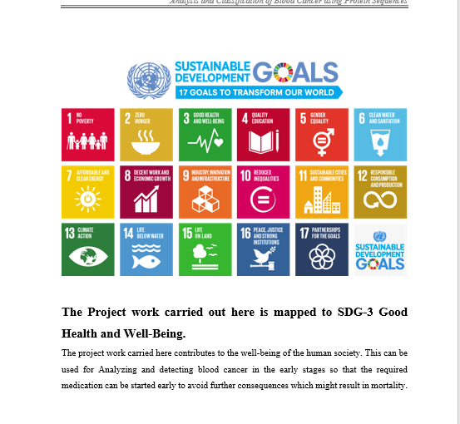
Project work mapping with SDG

Slide 19
Thank You

